Slide 1





COLLEGE WISHLIST

Slide 2
















Dashboard
AGENDA
Trends in Policies, Practices, and Experiences
Transforming, Indexing, and Building
Informative, Accessible, and Thorough Interface
research
data
dashboard
PROJECT RATIONALE & PROBLEM SCOPE
DATA SOURCES
KEY THEMES IN AID POLICIES & PRACTICES
CASES AT-A-GLANCE
CALCULATING ECONOMIC MOBILITY INDICES (EMIs)
GEOGRAPHY-BASED IMPLICATIONS
INFORMATION ARCHITECTURE
DEMONSTRATION

Slide 3
research
The College Wish List offers families a more accessible and comprehensive tool for choosing the right college, considering not only the economic mobility of the institution but also other important factors such as cost of living, setting, retention rates, and research intensity.
PROJECT RATIONALE & PROBLEM SCOPE
DATA SOURCES
KEY THEMES IN AID POLICIES & PRACTICES
Dashboard
AGENDA
Carnegie Classification of Institutions of Higher Education
Integrated Post Secondary Education Data System
a framework for categorizing colleges and universities in the United States
a system of interrelated surveys conducted annually by the National Center for Education Statistics (NCES)
Social Mobility Index
Economic Mobility Index
a college ranking system that measures the extent to which colleges and universities promote upward social mobility for their students
a rating system for institutions of higher education based on their ability to promote economic mobility for their graduates
data
dashboard
CASES AT-A-GLANCE
CALCULATING ECONOMIC MOBILITY INDICES (EMIs)
GEOGRAPHY-BASED IMPLICATIONS
INFORMATION ARCHITECTURE
DEMONSTRATION

Slide 4
The College Wish List offers families a more accessible and comprehensive tool for choosing the right college, considering not only the economic mobility of the institution but also other important factors such as cost of living, setting, retention rates, and research intensity.
research
PROJECT RATIONALE & PROBLEM SCOPE
DATA SOURCES
KEY THEMES IN AID POLICIES & PRACTICES
Dashboard
AGENDA
Carnegie Classification of Institutions of Higher Education
Social Mobility Index
Integrated Post Secondary Education Data System
Economic Mobility Index
data
dashboard
CASES AT-A-GLANCE
CALCULATING ECONOMIC MOBILITY INDICES (EMIs)
GEOGRAPHY-BASED IMPLICATIONS
INFORMATION ARCHITECTURE
DEMONSTRATION

Slide 5
The College Wish List offers families a more accessible and comprehensive tool for choosing the right college, considering not only the economic mobility of the institution but also other important factors such as cost of living, setting, retention rates, and research intensity.
research
Integrated Post Secondary Education Data System
How will programs with high EMIs fare when additional college choice considerations are included?
PROJECT RATIONALE & PROBLEM SCOPE
DATA SOURCES
KEY THEMES IN AID POLICIES & PRACTICES
Dashboard
AGENDA
Carnegie Classification of Institutions of Higher Education
Economic Mobility Index
Social Mobility Index
data
dashboard
CASES AT-A-GLANCE
CALCULATING ECONOMIC MOBILITY INDICES (EMIs)
GEOGRAPHY-BASED IMPLICATIONS
INFORMATION ARCHITECTURE
DEMONSTRATION

Slide 6
The College Wish List offers families a more accessible and comprehensive tool for choosing the right college, considering not only the economic mobility of the institution but also other important factors such as cost of living, setting, retention rates, and research intensity.
research
How will programs with high EMIs fare when additional college choice considerations are included?
Is there a relationship between an institution’s location on EMI?
PROJECT RATIONALE & PROBLEM SCOPE
DATA SOURCES
KEY THEMES IN AID POLICIES & PRACTICES
Dashboard
AGENDA
Social Mobility Index
Integrated Post Secondary Education Data System
Carnegie Classification of Institutions of Higher Education
Economic Mobility Index
data
dashboard
CASES AT-A-GLANCE
CALCULATING ECONOMIC MOBILITY INDICES (EMIs)
GEOGRAPHY-BASED IMPLICATIONS
INFORMATION ARCHITECTURE
DEMONSTRATION

Slide 7
research
PROJECT RATIONALE & PROBLEM SCOPE
DATA SOURCES
KEY THEMES IN AID POLICIES & PRACTICES
Dashboard
AGENDA
Regardless of how much aid schools offer, families still contend with non-financial considerations to truly understand the value of a package:
The cost of living being high around the school can make it difficult for the student to afford housing, food, and generally enjoy themselves.
Settings not only inform the cost of living but also affect other important considerations, such as the opportunities throughout the school year and ease of travelling home during break.
High retention rates after the first year can be a strong indicator of a university's ability to provide academic and social support to its students.
Research intensity can provide opportunities for students to participate in research and gain valuable experience in their field of study. This can lead to increased job prospects after graduation and stronger graduate program applications.
The dashboard will offer the user the opportunity to filter along these lines.
data
CASES AT-A-GLANCE
CALCULATING ECONOMIC MOBILITY INDICES (EMIs)
GEOGRAPHY-BASED IMPLICATIONS
data
dashboard
CASES AT-A-GLANCE
CALCULATING ECONOMIC MOBILITY INDICES (EMIs)
GEOGRAPHY-BASED IMPLICATIONS
INFORMATION ARCHITECTURE
DEMONSTRATION

Slide 8
data
CASES AT-A-GLANCE
CALCULATING ECONOMIC MOBILITY INDICES (EMIs)
GEOGRAPHY-BASED IMPLICATIONS
Dashboard
PRICE-TO-EARNINGS PREMIUM (PEP)
AGENDA
Total Average Net Price
Post-Enrollment Earnings – Typical Salary of H.S. Grad
percentage of students within each income level on campus
ECONOMIC MOBILITY INDEX
PEP x Percentage
PELL_EMI
PEP x Pell Percentage
Source: Opportunity Insights (2020)
dashboard
INFORMATION ARCHITECTURE
DEMONSTRATION
research
dashboard
PROJECT RATIONALE & PROBLEM SCOPE
DATA SOURCES
KEY THEMES IN AID POLICIES & PRACTICES
INFORMATION ARCHITECTURE
DEMONSTRATION

Slide 9
data
CASES AT-A-GLANCE
CALCULATING ECONOMIC MOBILITY INDICES (EMIs)
GEOGRAPHY-BASED IMPLICATIONS
Dashboard
PRICE-TO-EARNINGS PREMIUM (PEP)
AGENDA
Total Average Net Price
Post-Enrollment Earnings – Typical Salary of H.S. Grad
percentage of students within each income level on campus
ECONOMIC MOBILITY INDEX
PEP x Percentage
PELL_EMI
INC1_EMI
INC2_EMI
INC3_EMI
PEP x Pell Percentage
PEP x Percentage
PEP x Percentage
PEP x Percentage
< $30,000
$30,001 - $48,000
$48,001 - $75,000
$75,000 - $ 110,000
research
dashboard
PROJECT RATIONALE & PROBLEM SCOPE
DATA SOURCES
KEY THEMES IN AID POLICIES & PRACTICES
INFORMATION ARCHITECTURE
DEMONSTRATION

Slide 10
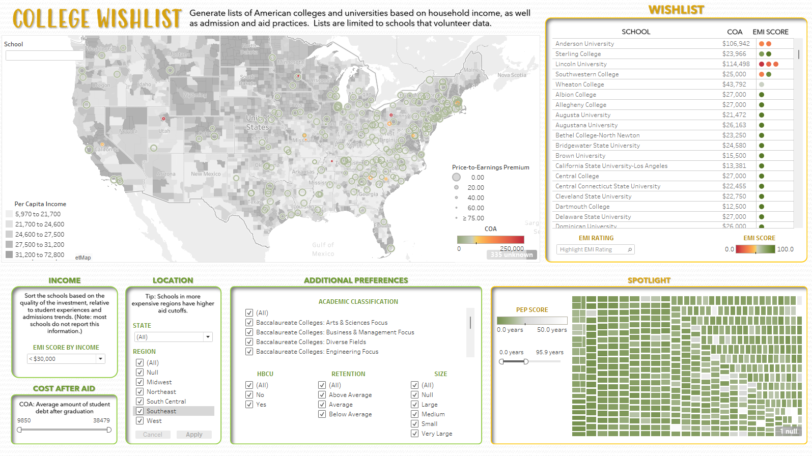
dashboard
INFORMATION ARCHITECTURE
DEMONSTRATION
Dashboard
AGENDA
Cost of Living & Setting
Economic Mobility by Income
Retention Rate
Price-to-Earnings Premium
research
data
PROJECT RATIONALE & PROBLEM SCOPE
DATA SOURCES
KEY THEMES IN AID POLICIES & PRACTICES
CASES AT-A-GLANCE
CALCULATING ECONOMIC MOBILITY INDICES (EMIS)
GEOGRAPHY-BASED IMPLICATIONS

